Slide 1
Simulators for serial robots

Slide 2
What is simulation software?
Simulation software is a framework which consists of tools and libraries essential to define a proper environment for deploying a virtual robot to examine its behavior in performing various tasks under pre-defined constraints. It has a GUI to interact with the robot. Languages like C/C++, Perl are used as scripting languages to form a low level API for controlling the environment.
The simulation tool helps the user understand the capabilities and drawbacks in the deployed machine.

Slide 3
Features of a Robotic Simulator
• Employing physics engine to produce realistic movements eg. Physx
• Realistic 3d rendering - tools required to build the suitable environment
• Dynamic robot bodies with scripting - using C/C++, Perl, Python for building a low level interface between the virtual robot and the simulator.
• Cloud simulation
• Extensive command line tools
• It uses SDF to define the objects, Robot models for simulation and control.
Notes:
SDF - (Spatial Data File) is an XML format which is used for describing objects and the environment for scientific application in robotics domain.

Slide 4
Gazebo
An open source simulator developed by USC to simulate the robots in outdoor environment.
It allows importing the particular model to a scene. The model editor in gazebo can be used to develop collision objects like cube, cylinder etc. It also provides RTF(real time factor) which is ratio of simulation time to real time. RTF is the measure of how fast or slow the simulation is takes place with respect to real time.
Notes:
RTF = (Simulation Time/ Real Time)

Slide 5
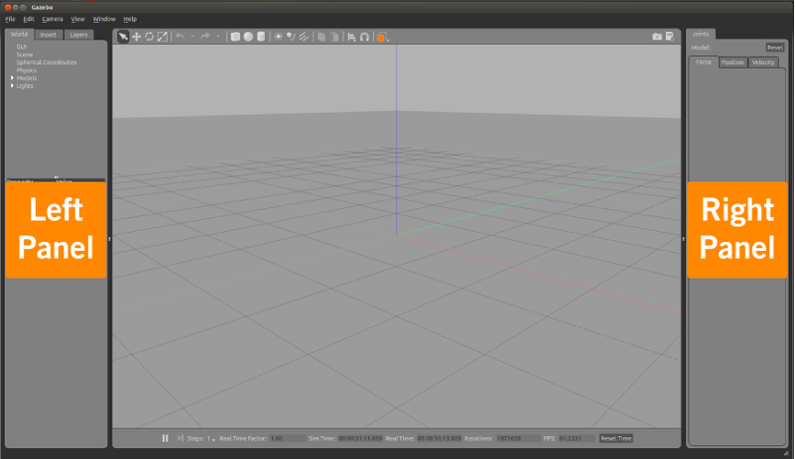
Gazebo GUI

Slide 6
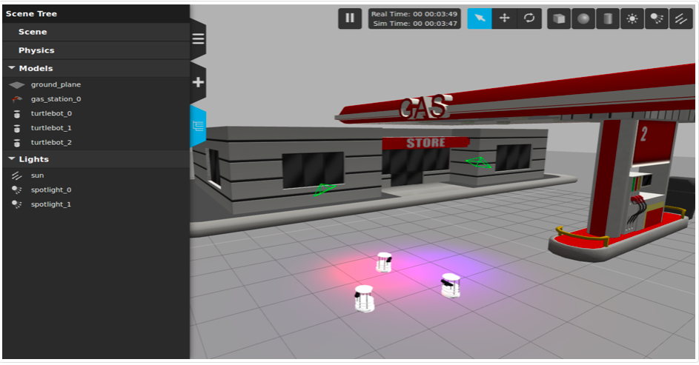
Gzweb
Notes:
The gzclient executable runs a QT based user interface. This application provides a nice visualization of simulation, and convenient controls over various simulation properties. gzclient is used as a GUI to interact with the gzserver.

Slide 7
Gazebo’s working
The gazebo command actually runs two different executables for you. The first is called gzserver, and the second gzclient.
The gzserver executable runs the physics update-loop and sensor data generation. This is the core of Gazebo, and can be used independently of a graphical interface. You may see the phrase "run headless" thrown about. This phrase equates to running only the gzserver. An example use case would involve running gzserver on a cloud computer where a user interface is not needed.
The gzclient executable runs a QT based user interface. This application provides a nice visualization of simulation, and convenient controls over various simulation properties.

Slide 8
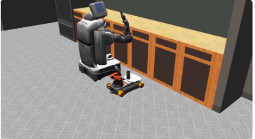
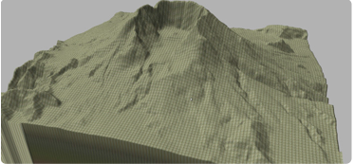
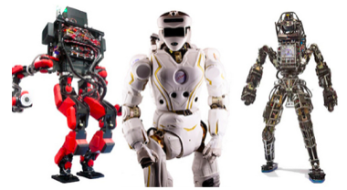

Slide 9
Klamp’t
This application was developed by Intelligent motion laboratory, Duke University.
Working- Unlike ROS, Klamp't is not an architecture for sensing and control on distributed hardware. Klamp't provides tools for modeling, planning, and simulation of robots with contact that are intended primarily for research and rapid prototyping. Klamp't comes with ROS bindings for its simulator and for reading point clouds. Klamp't is more cross-platform and lighter weight.
Klamp't differs from other robot simulators (e.g., Gazebo, Webots, V-REP) because it has better collision handling that lets it handle complex contact phenomena between unstructured meshes and even point clouds. Other simulators typically have better visualizations and sensor simulation capabilities.

Slide 10
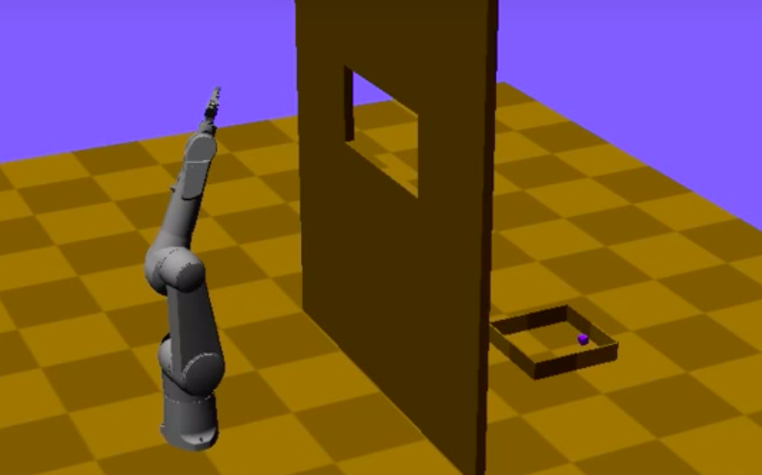
Klamp’t GUI

Slide 11
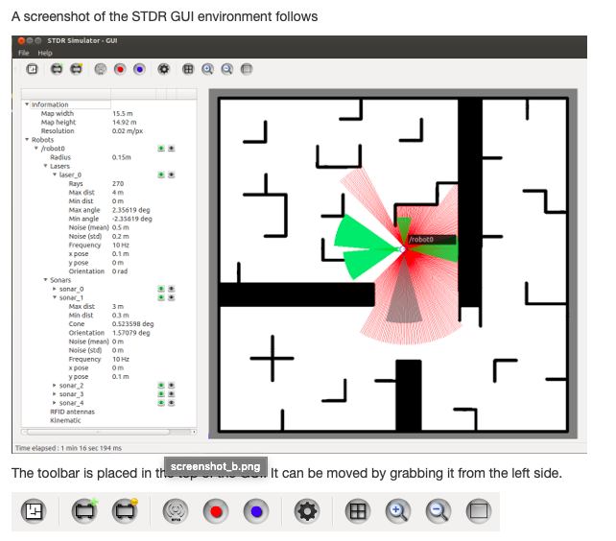
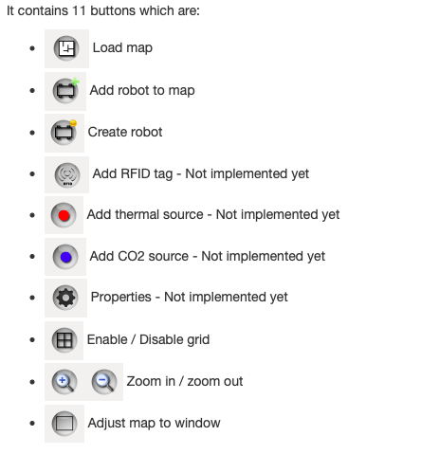
Stdr Architecture

Slide 12
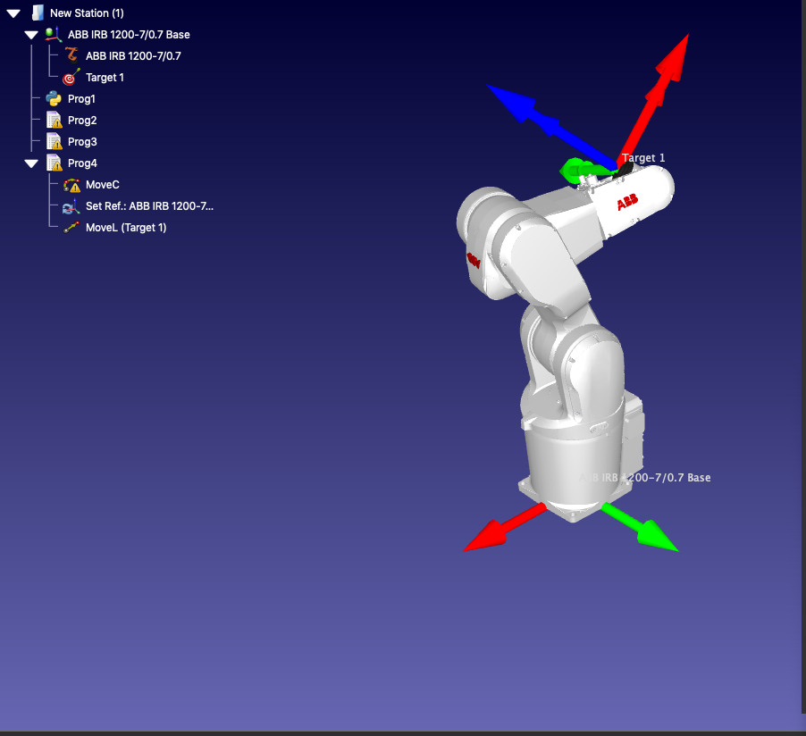
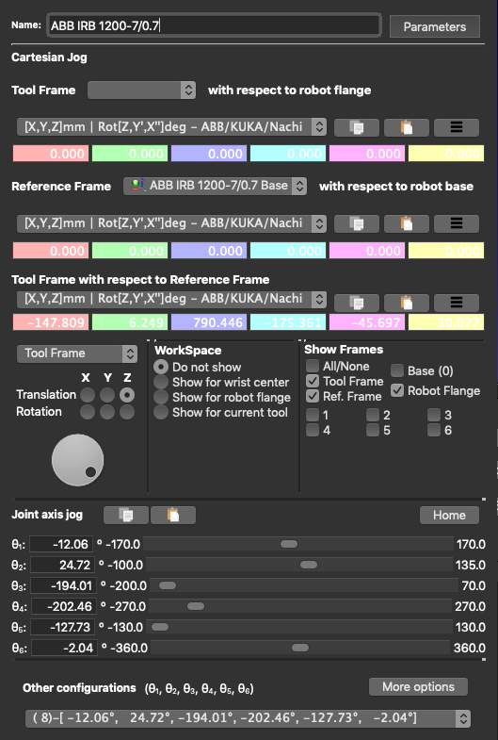
RoboDK simulator (Proprietary Simulator)
Notes:
RoboDK simulator has a feature of offline program generation in python.
Its also supports converting python file to DXF required to program a UR robot.

